Slide 1

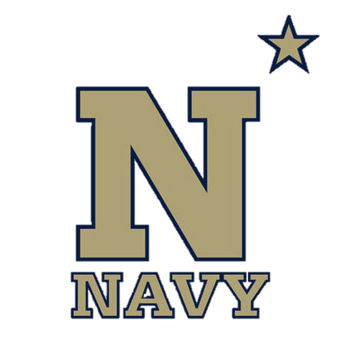
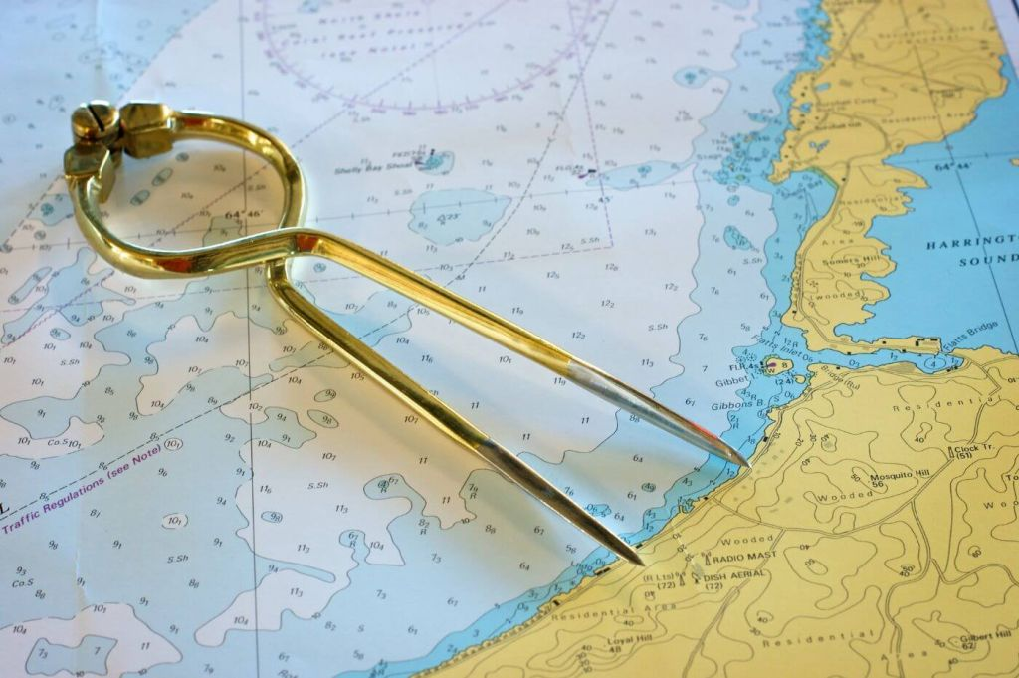
Nautical Chart Principles
NN220-02
SEANAV I United States Naval Academy
NN220 – Fundamentals of Navigation– Updated May 23
Operations Officer I HMS PROTECTOR A173 I The Ice Patrol Ship

Slide 2
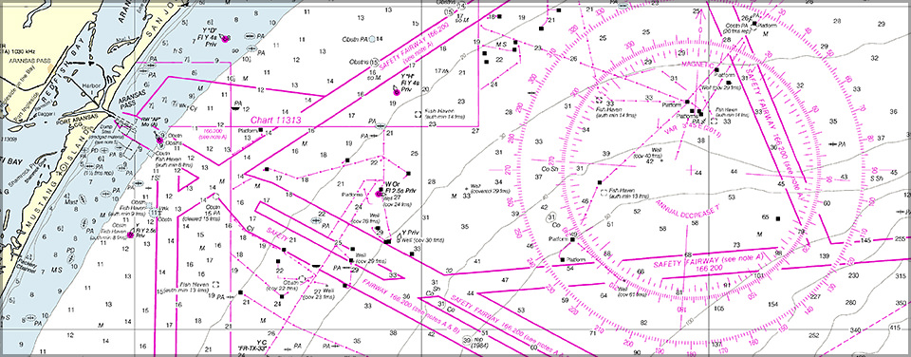
References
-The American Practical Navigator, Pub. No. 9, Bowditch, VOL. 1, 2019 Edition -Surface Ship Navigation Department Organizations and Regulations Manual (NAVDORM), COMNAVSURFPAC/COMNAVAIRPAC/COMNAVAIRLANT/COMNAVSURFLANT INSTRUCTION 3530.4 series
SEANAV I United States Naval Academy
NN220 – Fundamentals of Navigation
Operations Officer I HMS PROTECTOR A173 I The Ice Patrol Ship

Slide 3
Enabling Objectives
1 – DESCRIBE the science of Geodesy and its implications in navigation. 2 - UNDERSTAND the shape of the Earth as an ellipsoid and geoid.
3 - UNDERSTAND the development of the World Geodetic System.
4 – DESCRIBE the World Geodetic System of 1984.
5 – DEFINE the term Datum and Datum Shift.
6 – DESCRIBE the science of Hydrography and its implications in navigation.
7 – UNDERSTAND the different hydrographic survey techniques.
8 – DESCRIBE Category Zones of Confidence (CATZOC). 9 - DEFINE chart projection.
10 – DESCRIBE the major advantages and disadvantages of Mercator and Gnomonic Projections.
11 – UNDERSTAND Chart scale and the chart classifications by scale.
12 – LIST the major information features of a nautical chart. 13 - LIST the major chart distribution agencies. 14 - EXPLAIN the importance of Chart 1.
SEANAV I United States Naval Academy
NN220 – Fundamentals of Navigation
Operations Officer I HMS PROTECTOR A173 I The Ice Patrol Ship

Slide 4
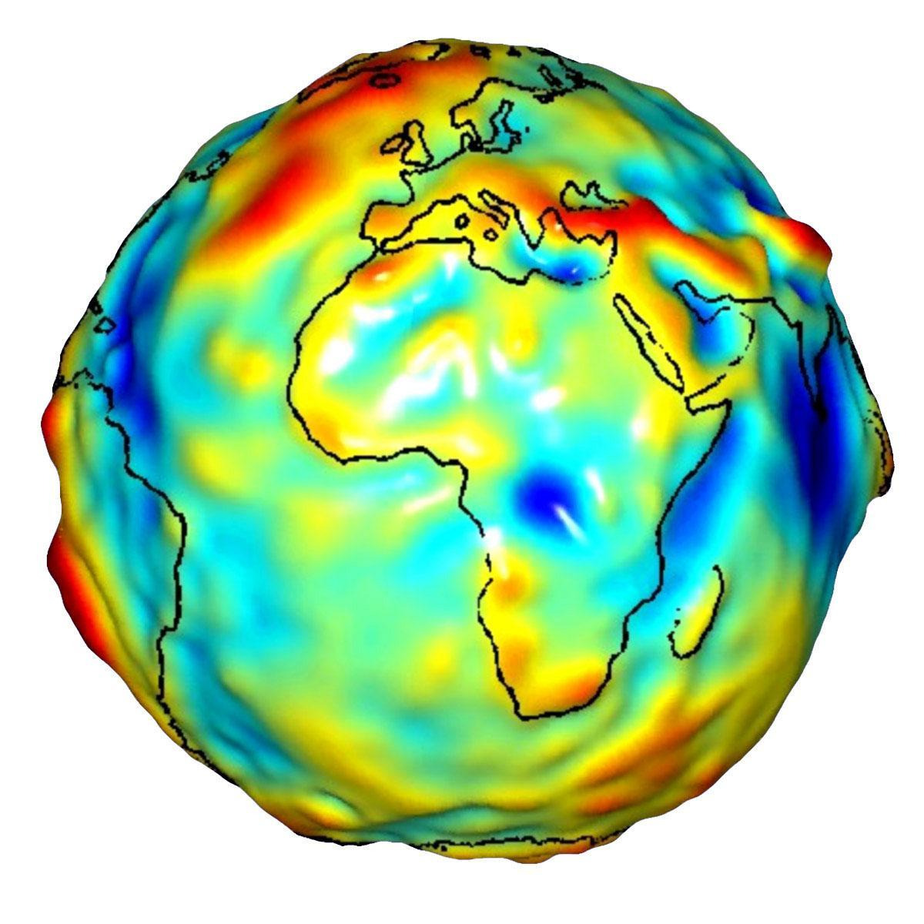
Geodesy, the Basis of Cartography
Geodesy-The application of mathematics to model the size and shape of the Earth. -Enables us to describe the Earth’s magnetic and gravitational fields. -From Geodesy, we developed a coordinate referencing system to precisely position and navigate 3-dimensionally across a global scale!
SEANAV I United States Naval Academy
NN220 – Fundamentals of Navigation
Operations Officer I HMS PROTECTOR A173 I The Ice Patrol Ship

Slide 5
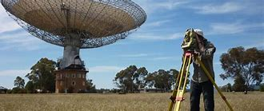
The Shape of the Earth
In Geodetic applications, three reference surfaces of the Earth are used:
A physical surface
Tangible and can be traversed and measured.
Used in more small scale projects.
An Ellipsoid
Reference for the surface which is completely mathematical.
Defines the Earth as an Ellipsoid, or an imperfect sphere. The Earth is wider at the Equator and flatter closer to the Poles.
A Geoid
Defines the Earth as a Geoid, or an irregular surface which has no complete mathematical expression.
SEANAV I United States Naval Academy
NN220 – Fundamentals of Navigation
Operations Officer I HMS PROTECTOR A173 I The Ice Patrol Ship

Slide 6
The Shape of the Earth
-Defining the Earth as a Geoid seems scientifically accurate.
Geoid models use a measurement called Mean Sea Level to give a fuller representation of the way the Earth’s surface varies in elevation.
Mean Sea Level is the elevation of the planet’s sea level surface if the water were completely flat — or without tides and currents.
-Defining the Earth as an Ellipsoid seems mathematically sound.
As an Ellipsoid model, Scientists can develop a consistent mathematical model of the Earth.
-It seems we have a bit of a contradiction...
SEANAV I United States Naval Academy
NN220 – Fundamentals of Navigation
Operations Officer I HMS PROTECTOR A173 I The Ice Patrol Ship

Slide 7
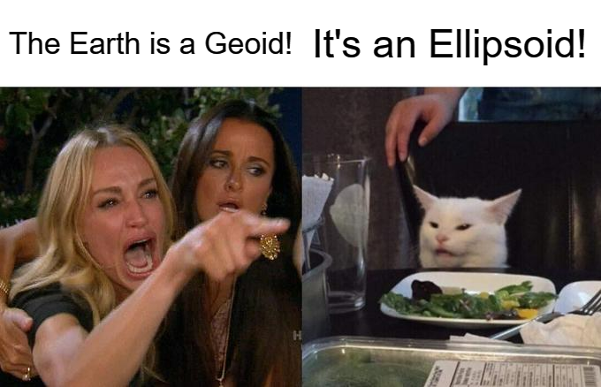
The Shape of the Earth
-Defining the Earth as a Geoid seems scientifically accurate.
Geoid models use a measurement called Mean Sea Level to give a fuller representation of the way the Earth’s surface varies in elevation.
Mean Sea Level is the elevation of the planet’s sea level surface if the water were completely flat — or without tides and currents.
-Defining the Earth as an Ellipsoid seems mathematically sound.
As an Ellipsoid model, Scientists can develop a consistent mathematical model of the Earth.
-It seems we have a bit of a contradiction...
SEANAV I United States Naval Academy
NN220 – Fundamentals of Navigation
Operations Officer I HMS PROTECTOR A173 I The Ice Patrol Ship

Slide 8
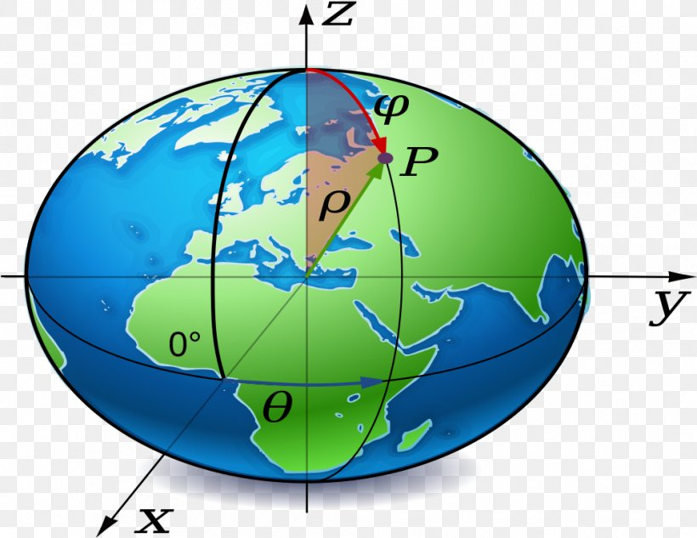
The Shape of the Earth
-The most accurate description of the Earth is probably as an oblate spheroid ellipsoid.
-Historically, ellipsoid models that have best fit the regional geoid models were used.
-This was great for regional purposes, but not worldwide.
-With the onset of Global Navigation Satellite Systems (GNSS), the globe-spanning ellipsoid models have proven to be more effective.
-The most common is the World Geodetic System (1984) ellipsoid model.
SEANAV I United States Naval Academy
NN220 – Fundamentals of Navigation
Operations Officer I HMS PROTECTOR A173 I The Ice Patrol Ship

Slide 9
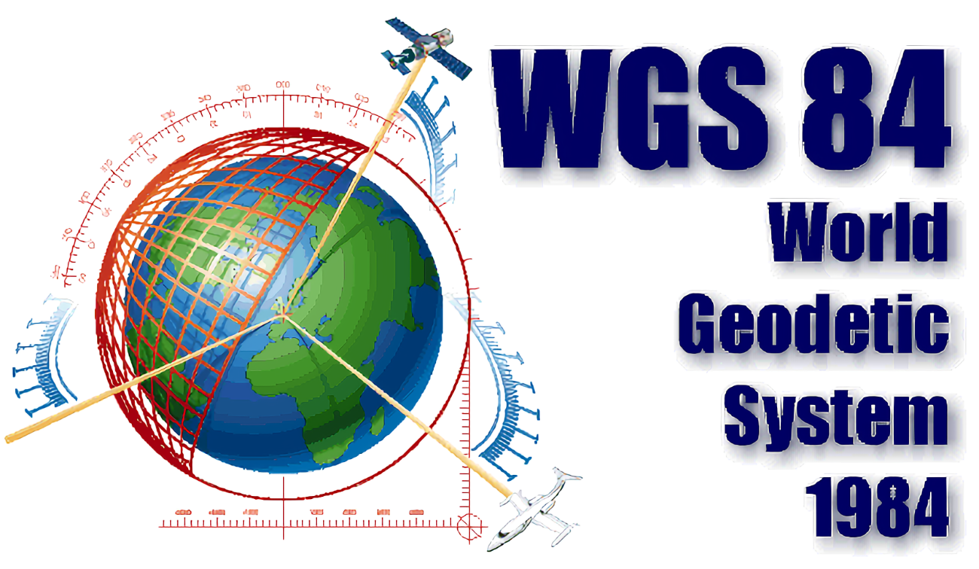
World Geodetic System of 1984
-By late 1950’s, sophisticated weapon systems needed a better reference system. -Needed to be continental, possibly global. -DoD developed a geocentric reference system. This system was World Geodetic System of 1960. -Further refinement led to WGS72, and eventually WGS84.
SEANAV I United States Naval Academy
NN220 – Fundamentals of Navigation
Operations Officer I HMS PROTECTOR A173 I The Ice Patrol Ship

Slide 10
World Geodetic System of 1984
-The WGS system is not based on a single point. -Precision fixes by multiple satellite fixes and statistical methods. -Result is an ellipsoid model which fits the real surface of the Earth far more accurately than any other. -Applicable WORLDWIDE! -All regional datums can be referenced to WGS84. -On standard nautical charts, North American Datum of 1983 (NAD 83) is navigationally equivalent to WGS84.
SEANAV I United States Naval Academy
NN220 – Fundamentals of Navigation
Operations Officer I HMS PROTECTOR A173 I The Ice Patrol Ship

Slide 11
What is a Datum?
-A Datum is defined as something used as a basis for calculating or measuring.
-For the geodetic reference system, WGS 84 is our datum as it defines the basis for which our charts are developed.
-Nautical Charts, whether electronic or paper, designed using the WGS84 model will have the coordinate system aligned to the reference point for WGS84.
-Datums can also be used for the measurement of depth (feet or meters), height and distance.
-Our GPS systems utilize WGS84 as their reference point as well.
SEANAV I United States Naval Academy
NN220 – Fundamentals of Navigation
Operations Officer I HMS PROTECTOR A173 I The Ice Patrol Ship

Slide 12
Datums
https://www.youtube.com/watch?v=J3_SVXm0Fio
SEANAV I United States Naval Academy
NN220 – Fundamentals of Navigation
Operations Officer I HMS PROTECTOR A173 I The Ice Patrol Ship

Slide 13
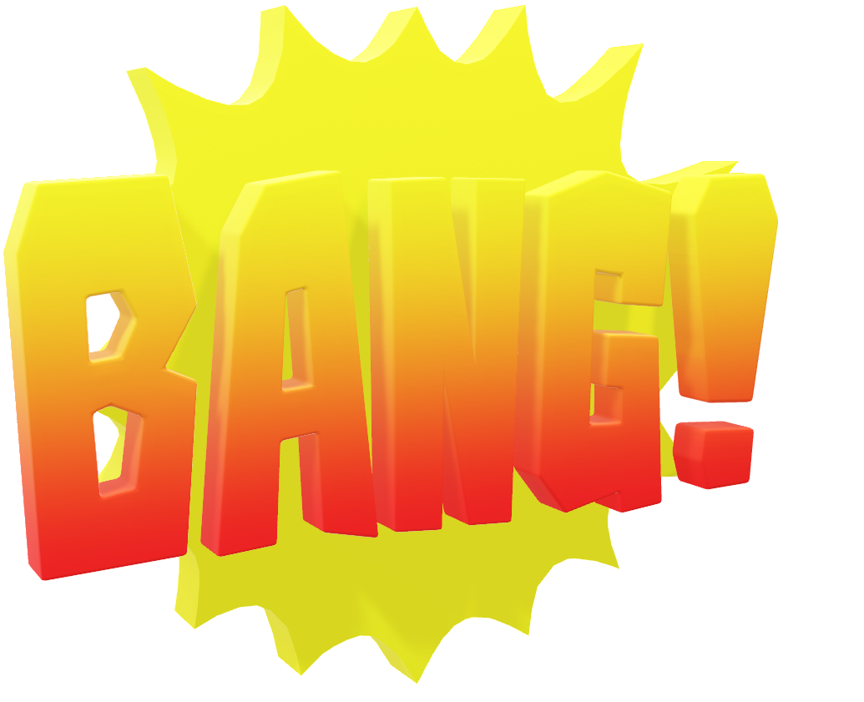
Datums
What happens if our navigation systems are using one reference datum and our nautical charts are using a different reference datum?
SEANAV I United States Naval Academy
NN220 – Fundamentals of Navigation
Operations Officer I HMS PROTECTOR A173 I The Ice Patrol Ship

Slide 14
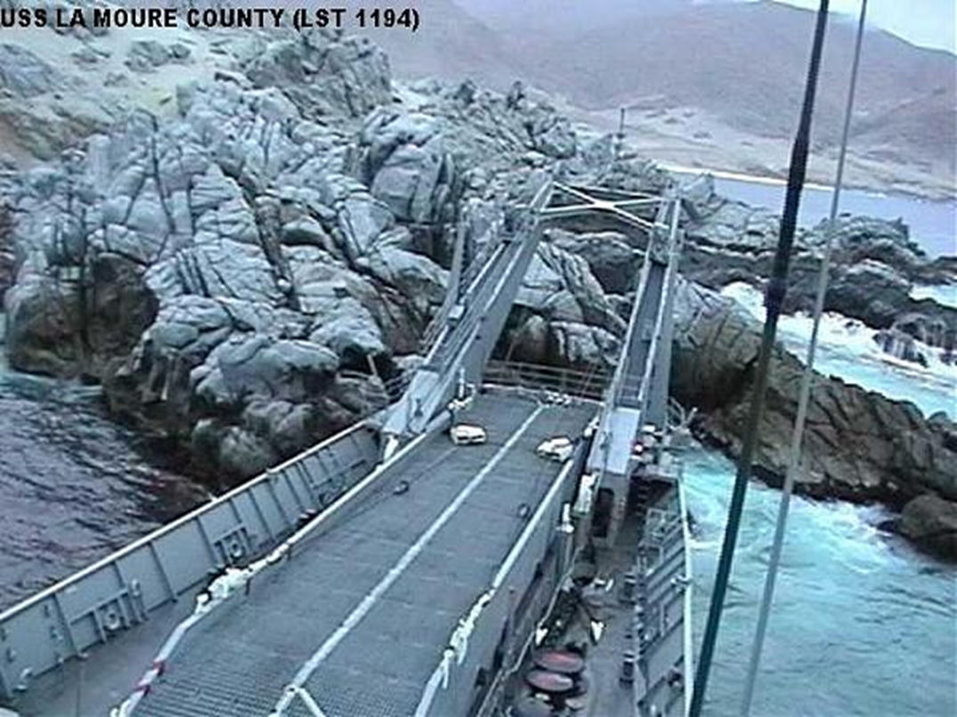

Slide 15
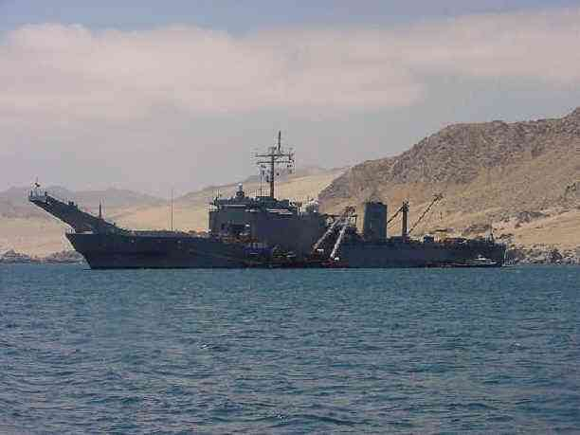
Datum Shift
-On September 12, 2000 USS La Moure County (LST 1194) ran aground in Cifuncho Bay, Chile during a joint USMC amphibious assault exercise. While transiting to the intended anchorage site in the early morning hours, the ship struck an outcropping of rock.
-Ship used a detailed Chilean chart (206) for transit to intended anchorage. The local chart was not compatible with WGS84. Thus GPS positions plotted on the local chart were in error.
-USS La Moure County experienced a Datum Shift, or when a navigation system provides a fix based on a different datum from that used on the nautical chart.
SEANAV I United States Naval Academy
NN220 – Fundamentals of Navigation
Operations Officer I HMS PROTECTOR A173 I The Ice Patrol Ship

Slide 16
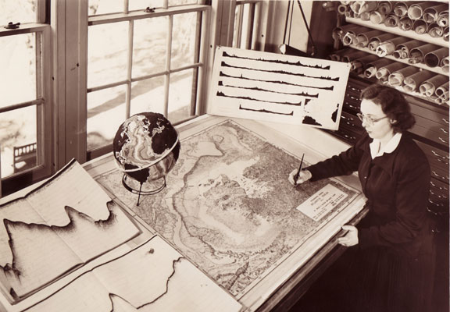
Hydrography and Cartography
Hydrography-The science of the measurement and description of the features which affect marine navigation, including water depths, shorelines, tides, currents, bottom type and undersea obstructions. Cartography-Transforms the scientific data taken by hydrography and converts it into a usable chart. This is the ultimate end of nautical chart production. -These scientific processes lay the foundation for how we develop the nautical charts we use today. -Geodesy is critical to cartography, as it determines the datum needed to create a nautical chart that is aligned with the applicable navigation systems. -How does hydrography factor in?
SEANAV I United States Naval Academy
NN220 – Fundamentals of Navigation
Operations Officer I HMS PROTECTOR A173 I The Ice Patrol Ship

Slide 17
Hydrographic
Surveys
-All nautical charts contain depth information that supports navigation.
-We have to know the depth of the water to safely navigate!
-Hydrographic Offices collect information from a wide variety of sources.
Ship Reports on water depth
Lead Line
Wire Drag
Echosounders (Single and Multi-beam)
Bathymetric LIDAR
-Hydrographers must first identify an area to be surveyed, determine the best method, and then the time it will take.
-Why does time matter?
SEANAV I United States Naval Academy
NN220 – Fundamentals of Navigation
Operations Officer I HMS PROTECTOR A173 I The Ice Patrol Ship

Slide 18
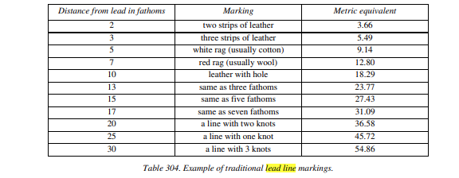
Lead Lines
-The Lead Line (pronounced like the periodic element)-is a device consisting of a marked line with a lead weight attached to one end. -The line is set at marked intervals in a way that allows quick depth determination. -The end may be wax or some other tractive substance to determine bottom type. -Probably the oldest hydrographic method, but still useful for determining depths along pier, determining bottom type and for grounding investigations.
SEANAV I United States Naval Academy
NN220 – Fundamentals of Navigation
Operations Officer I HMS PROTECTOR A173 I The Ice Patrol Ship

Slide 19
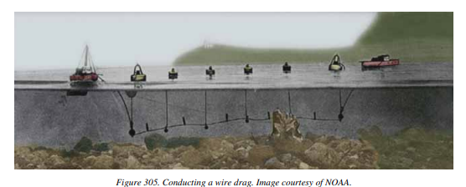
Wire Drag
-The Wire Drag, like the lead line, has been used for a long time. Designed to detect submerged features such as wrecks, rocks and obstructions in nearshore areas where under keel clearance is critical -The operating principle is simple; two vessels, a given distance apart, move in the same direction dragging a wire between them that has been set to a predetermined depth. If an obstacle is encountered, it will strike the wire. -The surveyors can then raise the wire to determine the least depth of the feature. In this manner, an area can be confidently verified, or 'swept' as free of hazards to a minimum depth. The exact nature and relief of the seafloor is not known, but the surveyors have physically verified that nothing exceeds the least depth of the wire.
SEANAV I United States Naval Academy
NN220 – Fundamentals of Navigation
Operations Officer I HMS PROTECTOR A173 I The Ice Patrol Ship

Slide 20
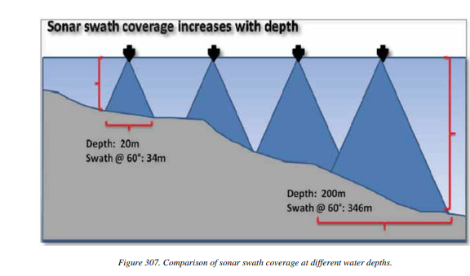
Echosounders
-Echosounders were developed in the 1920s. -Determines depth by measuring the time it takes a pulse of sound to travel from source, to seabed and back to source. -Device, called transducer, is usually mounted on the keel of a vessel. -Single Beam echosounder sends out a single pulse. -Multi-beam echosounder works by sending out many individual sonar pings, at a rate of many pulses per second, in a wide swath on either side of the vessel. -High frequency, high resolution best for coastal. -Low frequency, low resolution best for open ocean.
SEANAV I United States Naval Academy
NN220 – Fundamentals of Navigation
Operations Officer I HMS PROTECTOR A173 I The Ice Patrol Ship

Slide 21
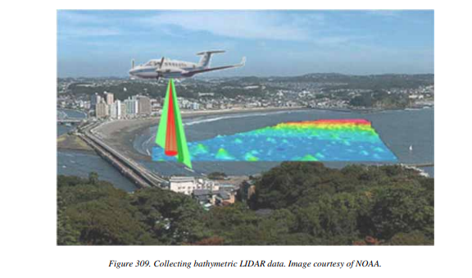
Bathymetric LIDAR
-Bathymetric LIDAR (Light Detection and Ranging)-uses laser transmitters to conduct hydrographic surveys from aircrafts. -Ideal for areas hazardous to traditional survey vessels (rocks, shoals, obstructions, etc). -Sensors are mounted on bottom of aircraft and transmit lasers on two bands, one for sea bed detection and one for sea surface detection. -Difference between the two determines depth of water! -Limited by the strength of the lasers and clarity of the water.
SEANAV I United States Naval Academy
NN220 – Fundamentals of Navigation
Operations Officer I HMS PROTECTOR A173 I The Ice Patrol Ship

Slide 22
Processing Hydrographic Data
-Hydrographic offices keep survey data and incorporate into nautical charts. -Data is evaluated to determine the degree of accuracy or uncertainty in measurements, otherwise called confidence. -This information is relayed to mariners through source diagram, chart note, Zone of Confidence Diagram, or a layer in digital charts. -Category Zones of Confidence (CATZOC) provide information about the quality and coverage of cartographic data in the area. -Developed by member nations in conjunction with IMO. -Criteria based on position accuracy, depth accuracy, seafloor coverage, and survey characteristics. -It cover six types, ranging from full seafloor coverage with significant feature detection to poor or unassessed areas.
SEANAV I United States Naval Academy
NN220 – Fundamentals of Navigation
Operations Officer I HMS PROTECTOR A173 I The Ice Patrol Ship

Slide 23
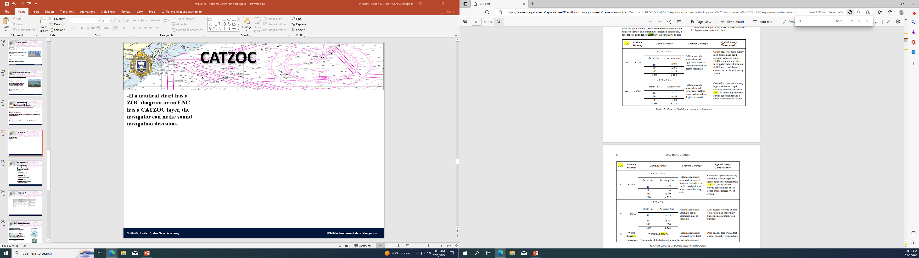
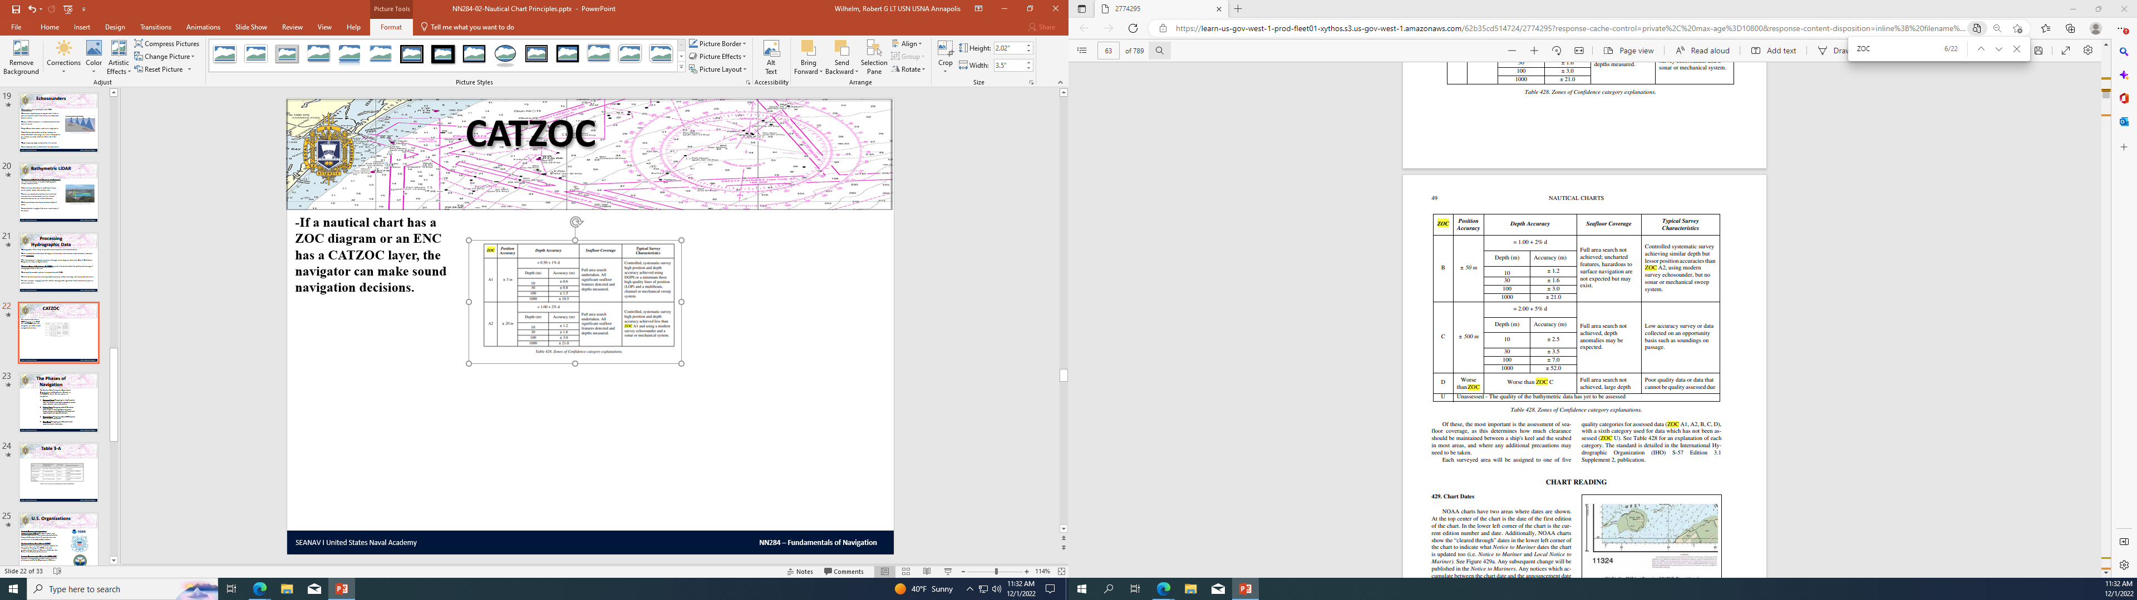
CATZOC
-If a nautical chart has a ZOC diagram or an ENC has a CATZOC layer, the navigator can make sound navigation decisions. -Make sure to check your charts to verify any ZOC discrepancies!
SEANAV I United States Naval Academy
NN220 – Fundamentals of Navigation
Operations Officer I HMS PROTECTOR A173 I The Ice Patrol Ship

Slide 24
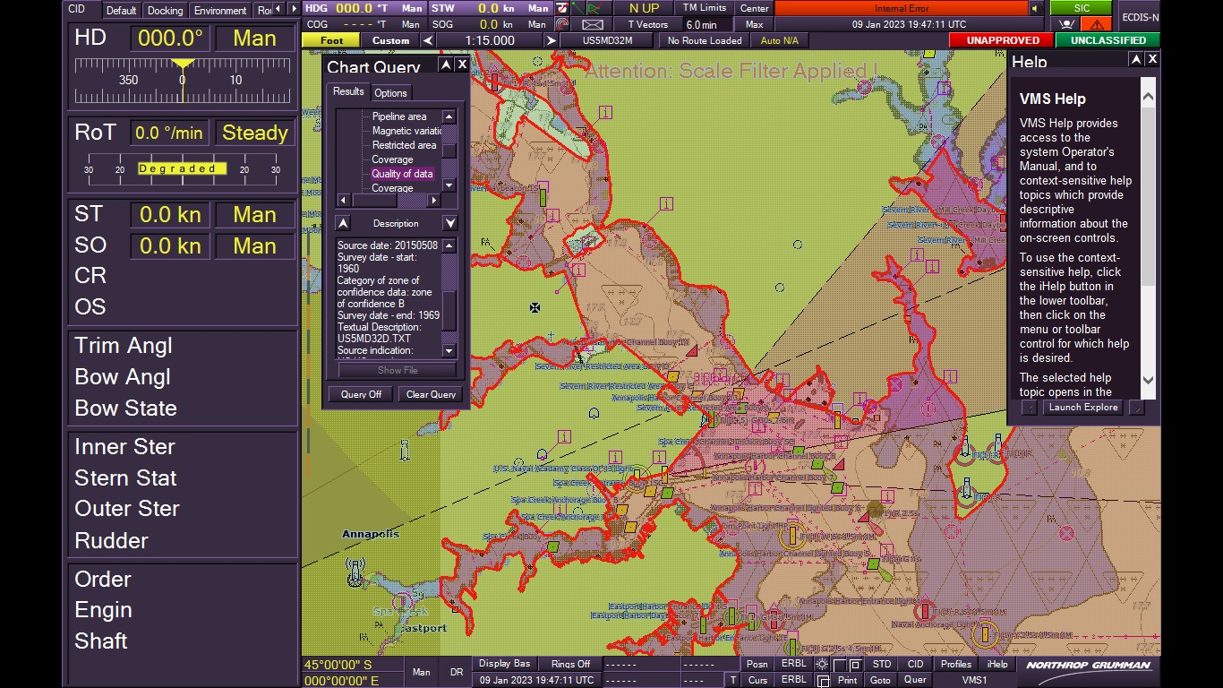
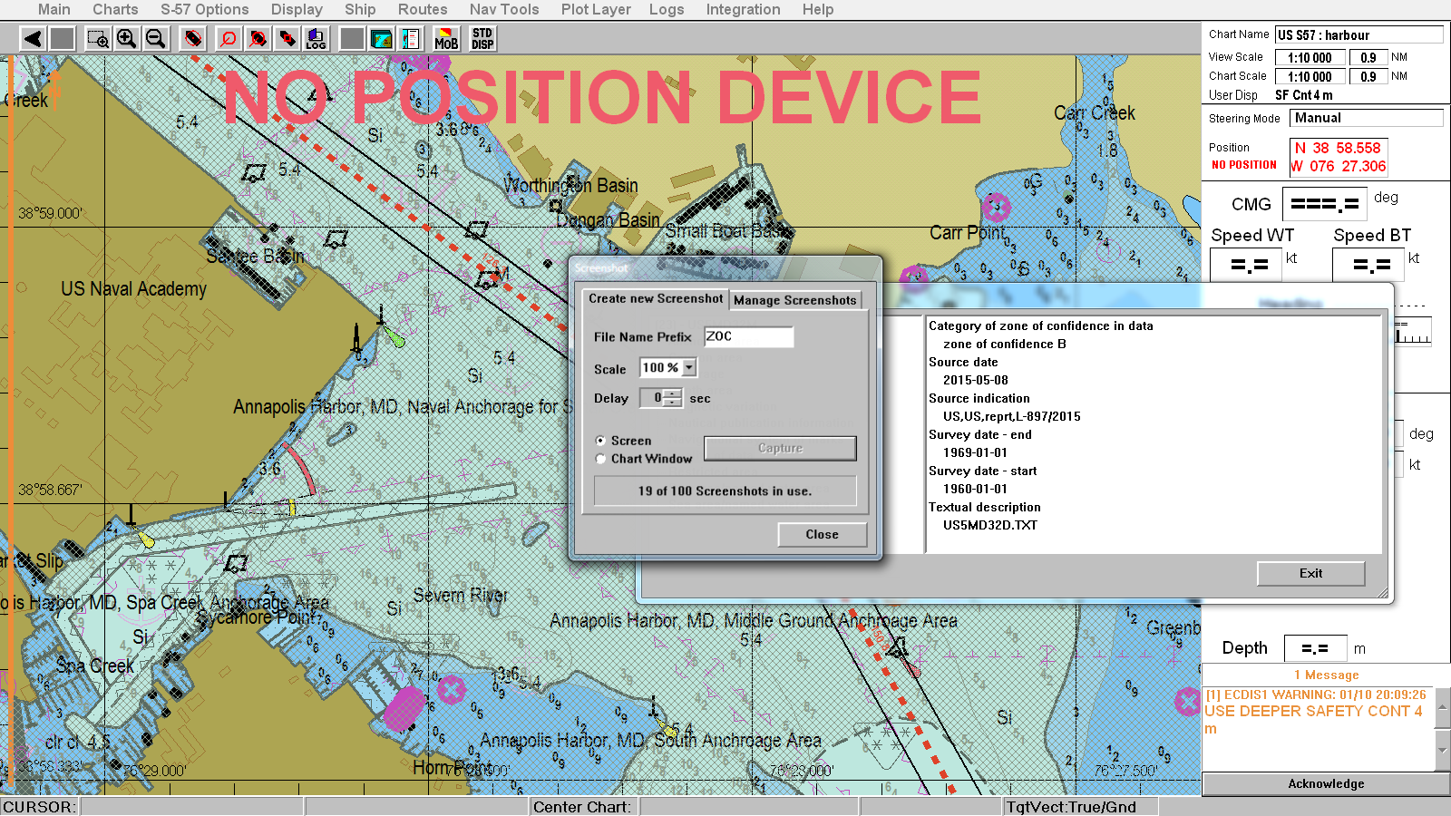
CATZOC
SEANAV I United States Naval Academy
NN220 – Fundamentals of Navigation
Operations Officer I HMS PROTECTOR A173 I The Ice Patrol Ship

Slide 25

BREAK (10 minutes)
SEANAV I United States Naval Academy
NN220 – Fundamentals of Navigation
Operations Officer I HMS PROTECTOR A173 I The Ice Patrol Ship

Slide 26
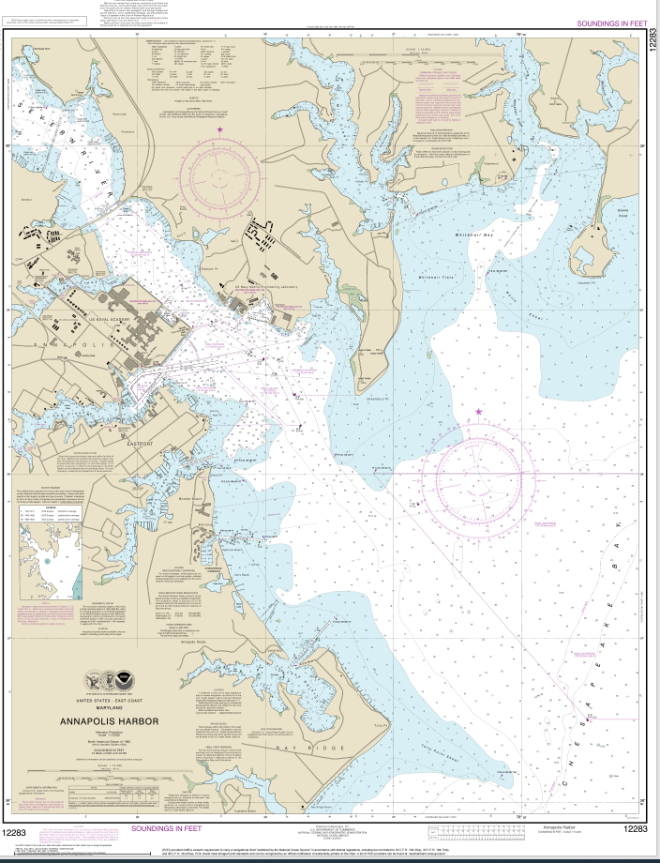
The Nautical Chart
-Representation of a portion of the Earth’s spherical surface;
-Are produced in different ways for different purposes;
-Because Earth is virtually round, it cannot be represented on a flat piece of paper without introducing some degree of distortion; and
-The properties most desirable in nautical charts are:
True shape of physical features
Areas represented in correct relative proportions
Correct angular relationships
Distances are constant everywhere on the chart
Great circles as straight lines
Rhumb lines as straight lines
SEANAV I United States Naval Academy
NN220 – Fundamentals of Navigation
Operations Officer I HMS PROTECTOR A173 I The Ice Patrol Ship

Slide 27
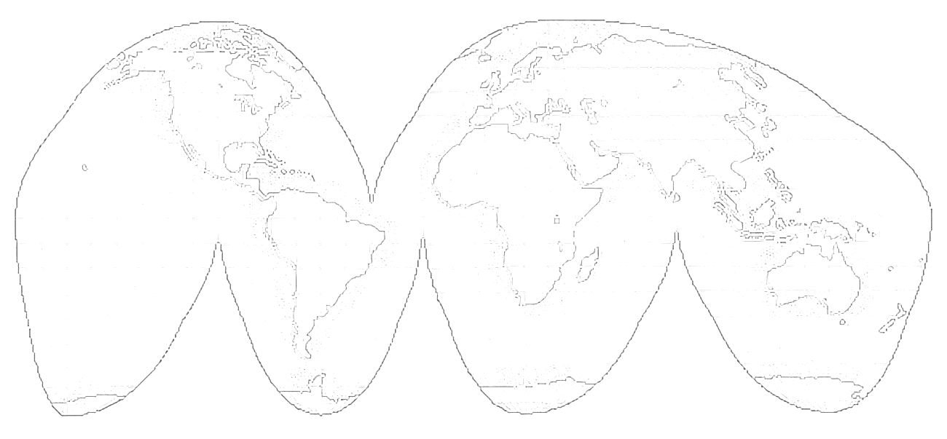
Chart Projections
-Cartographers can’t transfer a sphere to a flat surface without distortion. -They must project the surface of a sphere onto a developable surface, or one that can be flattened to form a plane. -This process is known as chart projection. -For Navigation, projections fall within 3 categories: plane, cylindrical or conic. -The most commonly used projections are Mercator Projections and Gnomonic Projections.
SEANAV I United States Naval Academy
NN220 – Fundamentals of Navigation
Operations Officer I HMS PROTECTOR A173 I The Ice Patrol Ship

Slide 28
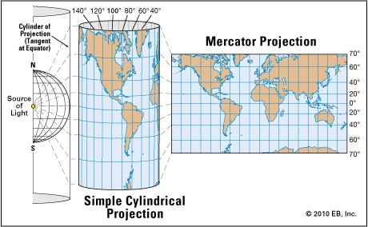
Mercator
Projections
-Mercator Projections are the most common projection used in maritime navigation, because Rhumb Lines are plotted as straight lines. -Distinguishing feature is that both meridians and parallels are expanded at the same ratio with increased latitude. -Visualized as the placement of a cylinder around the Earth. -Rhumb lines, meridians and parallels are represented as straight lines. -Meridians and parallels are perpendicular to each other, simplifying plotting position.
SEANAV I United States Naval Academy
NN220 – Fundamentals of Navigation
Operations Officer I HMS PROTECTOR A173 I The Ice Patrol Ship

Slide 29
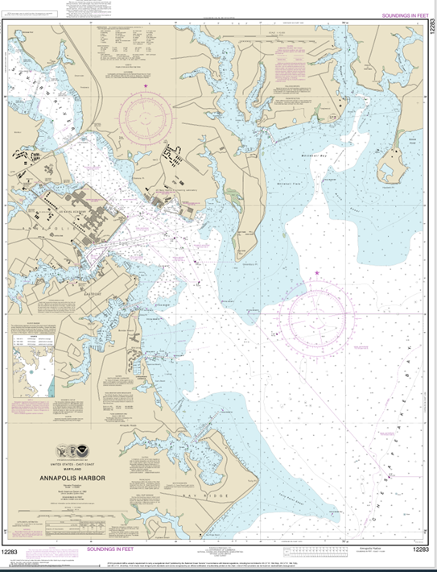
Mercator
Projections
SEANAV I United States Naval Academy
NN220 – Fundamentals of Navigation
Operations Officer I HMS PROTECTOR A173 I The Ice Patrol Ship

Slide 30
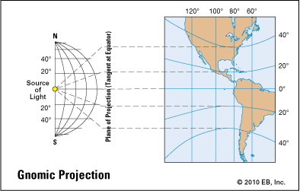
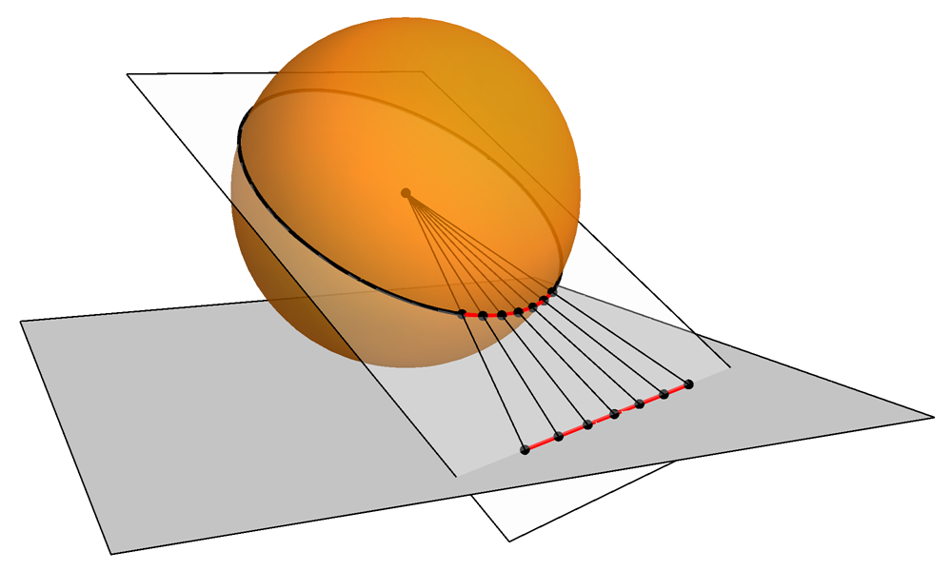
Gnomonic
Projections
-Gnomonic Projections is when the reference lines are projected from the center of the Earth onto a tangent plane (equator, at either poles or any other latitude). -Distinguishing feature is Great Circles are plotted as straight lines. -Ideal for trans-oceanic and long voyage plans.
SEANAV I United States Naval Academy
NN220 – Fundamentals of Navigation
Operations Officer I HMS PROTECTOR A173 I The Ice Patrol Ship

Slide 31
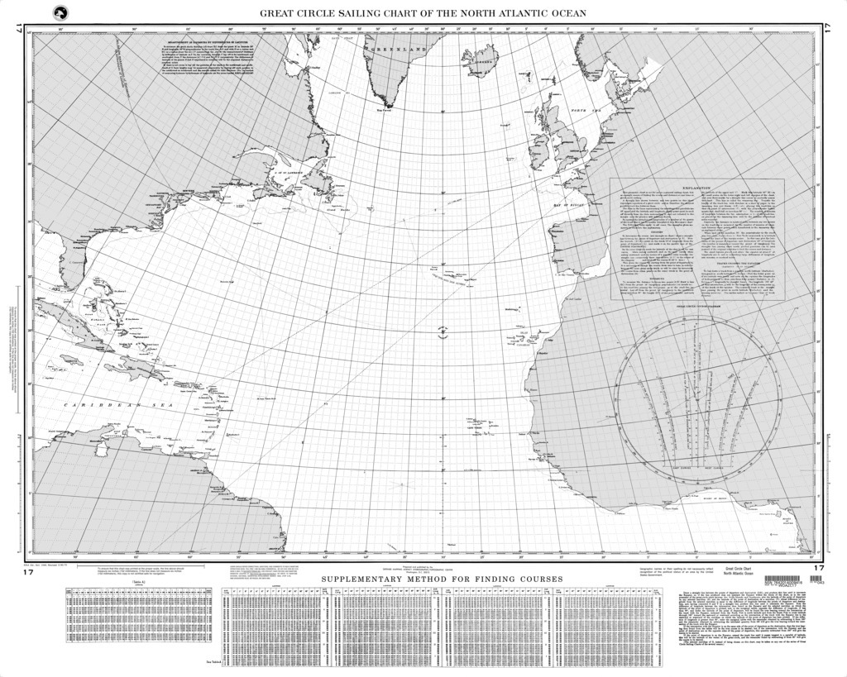
Gnomonic
Projections
SEANAV I United States Naval Academy
NN220 – Fundamentals of Navigation
Operations Officer I HMS PROTECTOR A173 I The Ice Patrol Ship

Slide 32
Mercator v. Gnomonic
Mercator Projections - Advantages: - Lat. and long. appear as a rectangular graticule (easy to plot positions, drawing of courses, etc.); - Easy to determine lat./long. of a position plotted; - Easy to measure distance (lat. scale – 1’ = 1NM); and - Easy to locate the four cardinal points. - Disadvantages: - Great-circle distances and directions are not readily determinable; - High distortion in extreme latitudes (~ 60º); and - No representation of the poles. Gnomonic Projections - Advantages: -All Great Circles are displayed as straight lines. - Disadvantages: -Distance and direction cannot be measured directly (unusable as a working chart); and -Distortion of shape and scale increases as distance from the center of the projection increases.
SEANAV I United States Naval Academy
NN220 – Fundamentals of Navigation
Operations Officer I HMS PROTECTOR A173 I The Ice Patrol Ship

Slide 33
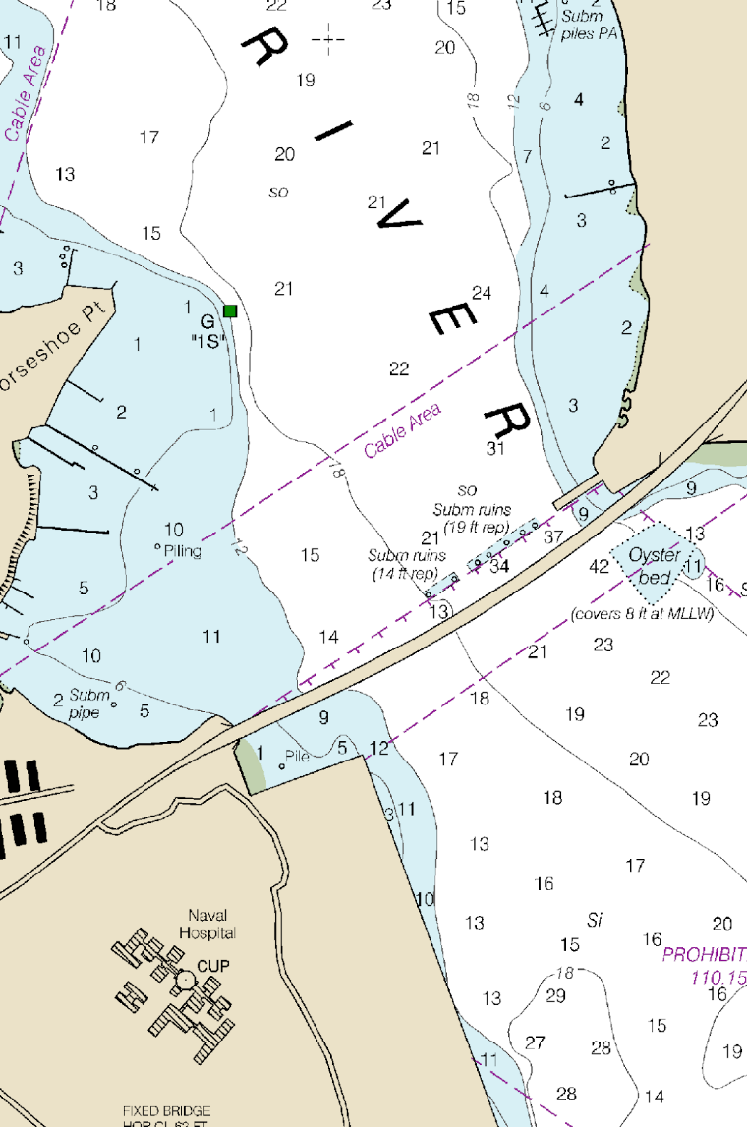
The Nautical Chart
-Chart is a graphic representation of a maritime area and adjacent coastal regions; and
-It shows:
Depths of water and heights of land;
Natural features of the seabed;
Details of the coastline;
Navigational hazards;
Location of natural and man-made aids to navigation;
Local details of the Earth’s magnetic field (variation);
Information on tides and currents; and
Man-made structures such as bridge and harbors.
SEANAV I United States Naval Academy
NN220 – Fundamentals of Navigation
Operations Officer I HMS PROTECTOR A173 I The Ice Patrol Ship

Slide 34
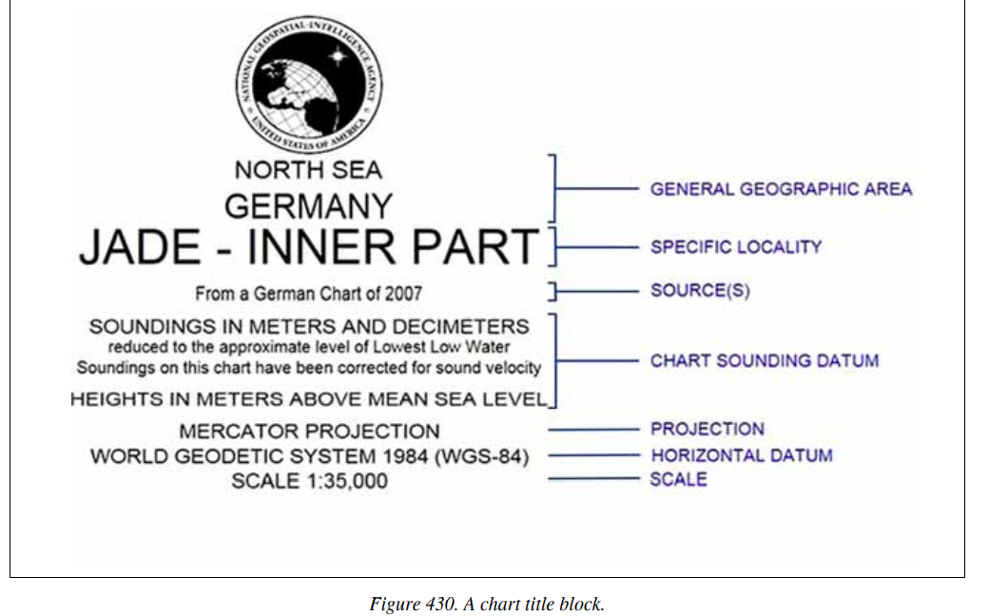
Title Block
MAIN INFORMATION:
Publisher
Region Information
Main Title
Projection and Scale
Datum
Depth and Elevation Notes
Cautionary Notes
Tidal Information
SEANAV I United States Naval Academy
NN220 – Fundamentals of Navigation
Operations Officer I HMS PROTECTOR A173 I The Ice Patrol Ship

Slide 35
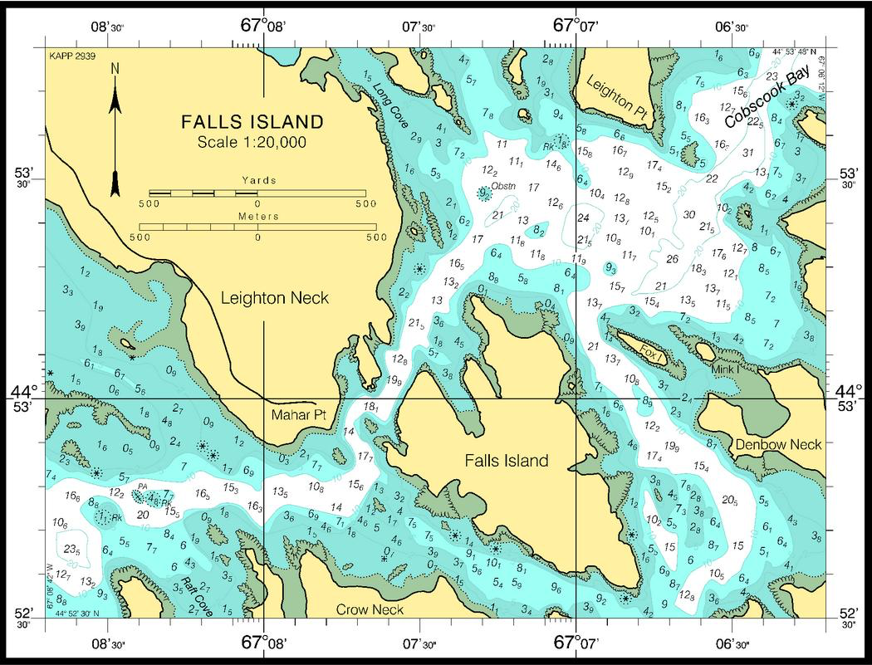
Chart Scales
-The scale of a chart is the ratio of a given distance on the chart to the actual distance which it represents on the earth.
-Ex.: Scale of 1:80,000 → means that one unit (inch, foot, meter, etc) on the chart represents 80,000 such units on the Earth.
-A chart covering a relatively large area is a small-scale chart.
-A chart covering a relatively small are is a large-scale chart.
SEANAV I United States Naval Academy
NN220 – Fundamentals of Navigation
Operations Officer I HMS PROTECTOR A173 I The Ice Patrol Ship

Slide 36
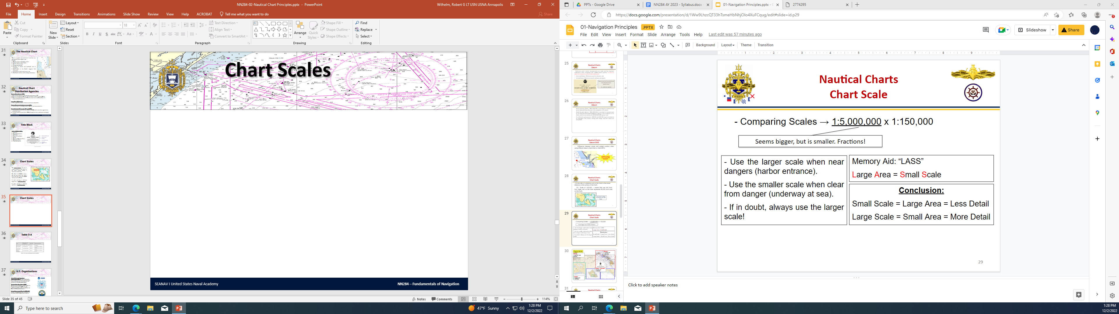
Chart Scales
SEANAV I United States Naval Academy
NN220 – Fundamentals of Navigation
Operations Officer I HMS PROTECTOR A173 I The Ice Patrol Ship

Slide 37
Chart Scales
-Charts are classified by scale
-Sailing Charts are the smallest scale charts, typically used for planning.
1:600,001 or smaller
-General Charts are intended for coastwise navigation outside of outlying reefs and shoals.
1:150,001-1:600,000
-Coastal Charts are intended for inshore coastwise navigation.
1:50,001-1:150,000
-Harbor Charts are intended for navigation and anchorage in harbors and small waterways.
Larger than 1:50,000
SEANAV I United States Naval Academy
NN220 – Fundamentals of Navigation
Operations Officer I HMS PROTECTOR A173 I The Ice Patrol Ship

Slide 38
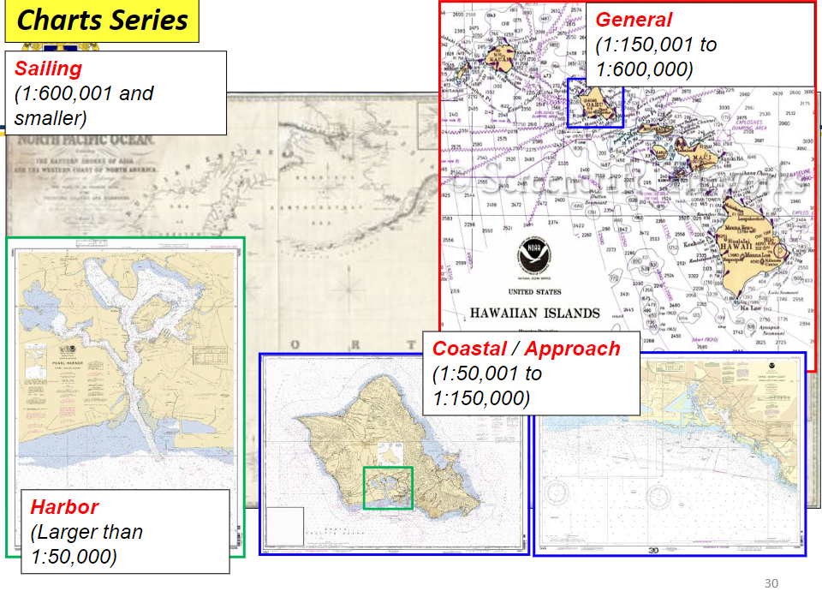
Chart Scales
SEANAV I United States Naval Academy
NN220 – Fundamentals of Navigation
Operations Officer I HMS PROTECTOR A173 I The Ice Patrol Ship

Slide 39
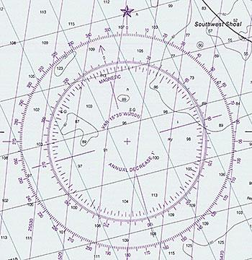
Compass Rose
-The Compass Rose is used to measure direction (true or magnetic) using slider/parallel ruler.
-It contains the local magnetic variation and the annual change, either an increase or decrease.
SEANAV I United States Naval Academy
NN220 – Fundamentals of Navigation
Operations Officer I HMS PROTECTOR A173 I The Ice Patrol Ship

Slide 40
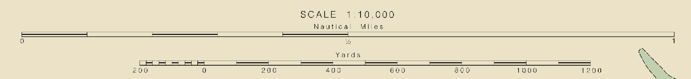
Distance Scale
-The Distance Scale is used to measure distances using a compass or divider.
SEANAV I United States Naval Academy
NN220 – Fundamentals of Navigation
Operations Officer I HMS PROTECTOR A173 I The Ice Patrol Ship

Slide 41
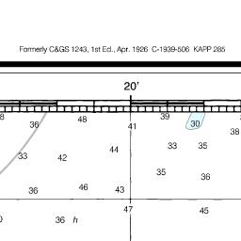
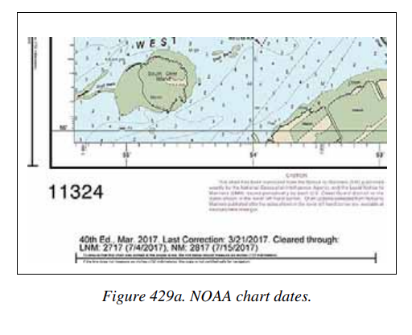
Chart Dates
-The chart will have two areas where the dates are shown.
-The top center will have date of the first edition.
-The lower left corner will have the current edition number and date.
-NOAA charts will also show “cleared through” dates in the lower left to indicate what NTM and LNM its updated too.
SEANAV I United States Naval Academy
NN220 – Fundamentals of Navigation
Operations Officer I HMS PROTECTOR A173 I The Ice Patrol Ship

Slide 42
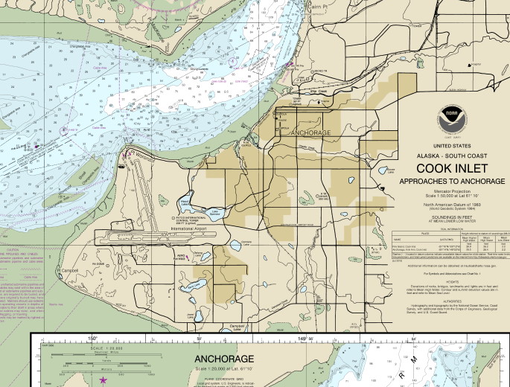
Shoreline
-The shoreline on chart represents the contact between land and water.
-Usually Mean High water line.
-Green shade represents areas that are exposed during low tides.
-If bottom type is mud, sand, gravel or stone, it will be noted.
If bottom type is coral or rock, appropriate symbol will be used.
SEANAV I United States Naval Academy
NN220 – Fundamentals of Navigation
Operations Officer I HMS PROTECTOR A173 I The Ice Patrol Ship

Slide 43
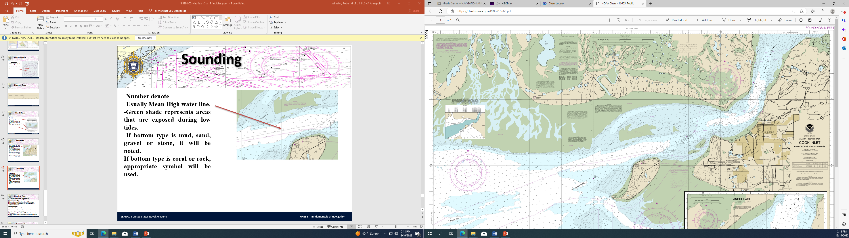
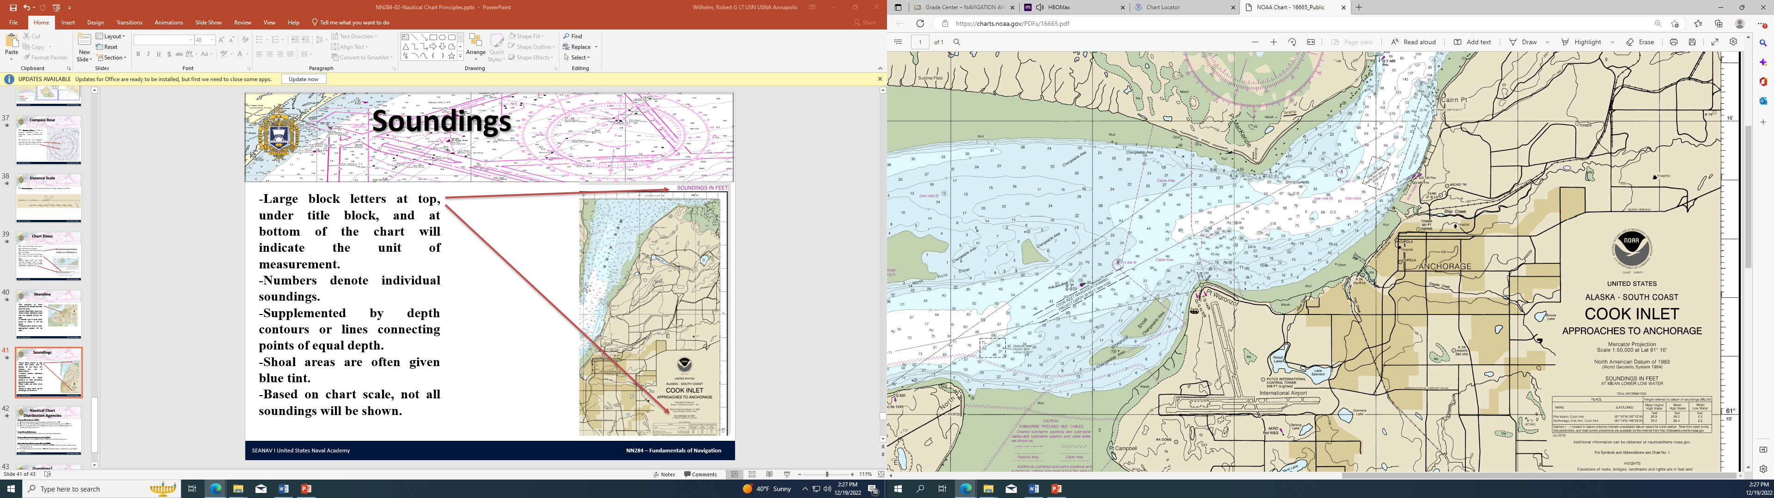
Soundings
-Large block letters at top, under title block, and at bottom of the chart will indicate the unit of measurement.
-Numbers denote individual sounding.
-Soundings are based on Mean Lower Low Water, the average height of the lowest tide recorded at a tide station each day during a 19-year recording period, known as a Tectonic Cycle.
-Supplemented by depth contours or lines connecting points of equal depth.
-Shoal areas are often given blue tint.
-Based on chart scale, not all soundings will be shown.
SEANAV I United States Naval Academy
NN220 – Fundamentals of Navigation
Operations Officer I HMS PROTECTOR A173 I The Ice Patrol Ship

Slide 44
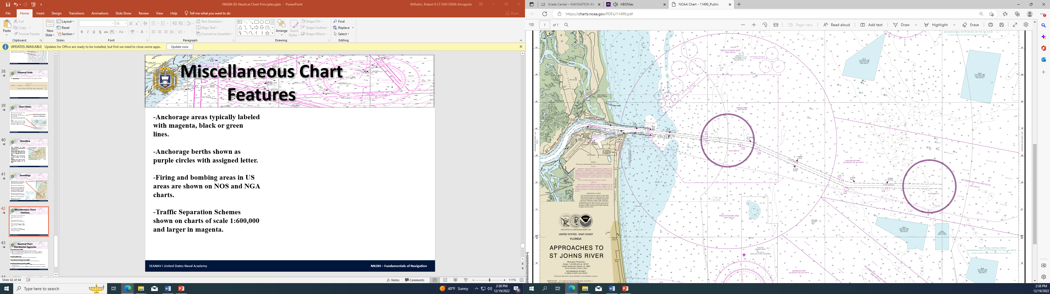
Miscellaneous Chart Features
-Anchorage areas typically labeled with magenta, black or green lines.
-Anchorage berths shown as purple circles with assigned letter.
-Firing and bombing areas in US areas are shown on NOS and NGA charts.
-Traffic Separation Schemes shown on charts of scale 1:600,000 and larger in magenta.
SEANAV I United States Naval Academy
NN220 – Fundamentals of Navigation
Operations Officer I HMS PROTECTOR A173 I The Ice Patrol Ship

Slide 45
The Nautical Chart
Ep 30: Navigation: The Nautical Chart - YouTube
SEANAV I United States Naval Academy
NN220 – Fundamentals of Navigation
Operations Officer I HMS PROTECTOR A173 I The Ice Patrol Ship

Slide 46
Nautical Chart Distribution Agencies
-National Ocean Service (NOS) Governmental agency for charting the coastal waters of US Division of the National Oceanic and Atmospheric Administration (NOAA) Charts are produced for coastal US waters, most rivers and Great Lakes for commercial and civilian use. -Army Corps Of Engineers Mississippi River (and its tributaries) and some inland lakes. -National Geospatial Intelligence Agency (NGA) Nautical charts for the Department of Defense and international use. -United Kingdom Hydrographic Office (UKHO) Nautical charts for the Ministry of Defense (MOD) and for maritime organizations around the world. Provided commercial portfolio of SOLAS compliant charts, publications and digital services.
SEANAV I United States Naval Academy
NN220 – Fundamentals of Navigation
Operations Officer I HMS PROTECTOR A173 I The Ice Patrol Ship

Slide 47
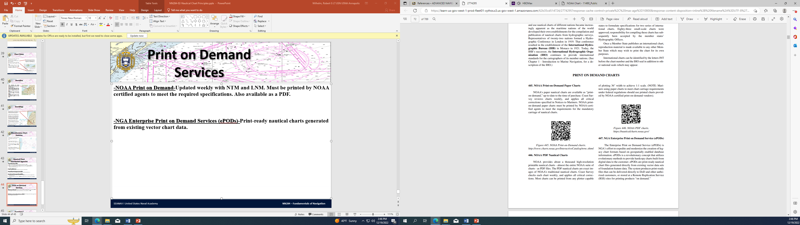
Print on Demand Services
-NOAA Print on Demand-Updated weekly with NTM and LNM. Must be printed by NOAA certified agents to meet the required specifications. Also available as a PDF. -NGA Enterprise Print on Demand Services (ePODs)-Print-ready nautical charts generated from existing vector chart data.
SEANAV I United States Naval Academy
NN220 – Fundamentals of Navigation
Operations Officer I HMS PROTECTOR A173 I The Ice Patrol Ship

Slide 48
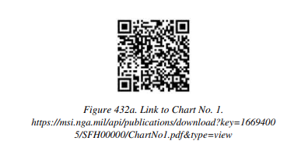
Chart No. 1
-Much of the chart information is shown by symbols. -These symbols aren’t to scale, but indicate the correct position of a feature to which they refer. -These symbols are listed in Chart No. 1, Symbols, Abbreviations and Terms used on paper and Electronic Navigation Charts.
SEANAV I United States Naval Academy
NN220 – Fundamentals of Navigation
Operations Officer I HMS PROTECTOR A173 I The Ice Patrol Ship

Slide 49
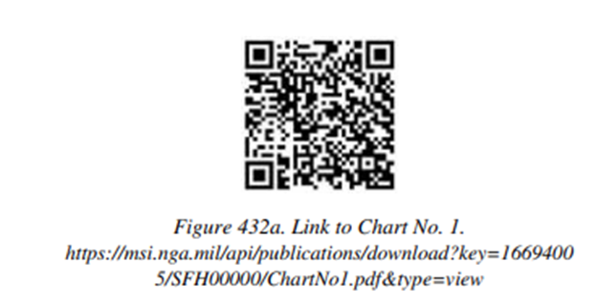
Chart No. 1
-Most of the symbols agree with recommendations made by IHO. -Some foreign charts may use slightly different symbols, so verify before you use!
SEANAV I United States Naval Academy
NN220 – Fundamentals of Navigation
Operations Officer I HMS PROTECTOR A173 I The Ice Patrol Ship

Slide 50
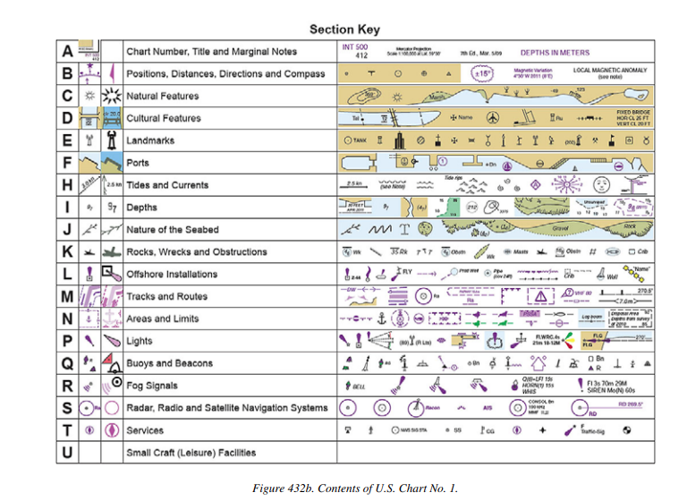
Chart No. 1
SEANAV I United States Naval Academy
NN220 – Fundamentals of Navigation
Operations Officer I HMS PROTECTOR A173 I The Ice Patrol Ship

Slide 51
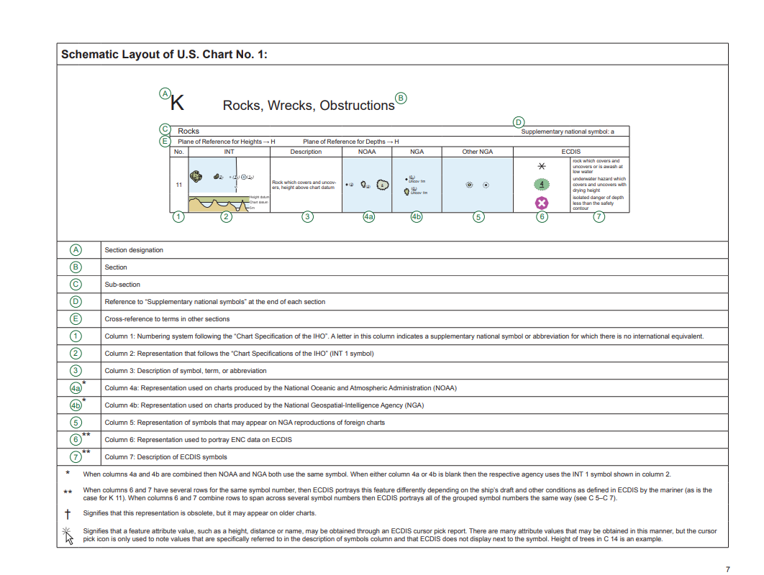
Chart No. 1
-Symbols in Chart No. 1 are organized by type in separate sections. -Information and examples of each symbol are displayed in eight columns.
SEANAV I United States Naval Academy
NN220 – Fundamentals of Navigation
Operations Officer I HMS PROTECTOR A173 I The Ice Patrol Ship

Slide 52
Chart No. 1
-Chart No. 1 is also organized according to subject matter. -Each specific subject is given a letter designator (i.e. K, J, etc) -Subjects are General, Topography, Hydrography, Aids and Services, and Indexes. -Chart No. 1 is a useful tool for navigators…if you are unsure of a symbol look it up!
SEANAV I United States Naval Academy
NN220 – Fundamentals of Navigation
Operations Officer I HMS PROTECTOR A173 I The Ice Patrol Ship

Slide 53
Enabling Objectives
1 – DESCRIBE the science of Geodesy and its implications in navigation. 2 - UNDERSTAND the shape of the Earth as an ellipsoid and geoid.
3 - UNDERSTAND the development of the World Geodetic System.
4 – DESCRIBE the World Geodetic System of 1984.
5 – DEFINE the term Datum and Datum Shift.
6 – DESCRIBE the science of Hydrography and its implications in navigation.
7 – UNDERSTAND the different hydrographic survey techniques.
8 – DESCRIBE Category Zones of Confidence (CATZOC). 9 - DEFINE chart projection.
10 – DESCRIBE the major advantages and disadvantages of Mercator and Gnomonic Projections.
11 – UNDERSTAND Chart scale and the chart classifications by scale.
12 – LIST the major information features of a nautical chart. 13 - LIST the major chart distribution agencies. 14 - EXPLAIN the importance of Chart 1.
SEANAV I United States Naval Academy
NN220 – Fundamentals of Navigation
Operations Officer I HMS PROTECTOR A173 I The Ice Patrol Ship

Slide 54
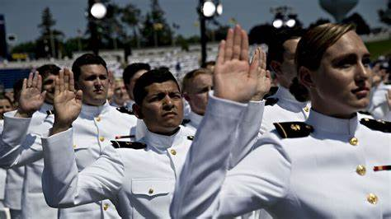
Questions?
SEANAV I United States Naval Academy
NN220 – Fundamentals of Navigation
Operations Officer I HMS PROTECTOR A173 I The Ice Patrol Ship

